Slide 1
Salesbit
A solution for stone excavation industry

Slide 2
Industry Overview
Stone excavation industry concerns with:-
Mining of stone
Breaking and processing of mined blocks
Managing inventory
Selling articles
Management of all entities involved in the business process

Slide 3
Mining Process Description
A block is excavated from a quarry and it is transported to a stockyard.
The Block is then either processed or sold directly.
If a block is processed, it is converted to slabs.
Those slabs are later polished then are sold to parties.

Slide 4
Problems faced by owners and managers
Inventory and sales management is done manually
Excel files are used for storage
Pdfs are manually created for reference
Searching and filtering is difficult
Difficult to get the summary of stock
Salesman dependent on manager
Well defined roles in the business
Repetition of data and manual discovery of data

Slide 5
Solution
A fully fledged stock and sales management web application
No need for installing software
Run irrespective of platforms
Manage logistics of articles
Manage all business processes

Slide 6
Objective
A web application/ERP that covers aspects of stock and sales management:-
1. A place to see records of all mined items.
2. Manage authority
3. Managing location of items and items in transit
4. Managing the sales workflow
5. Better overview and analytics

Slide 7
Project Timeline
This Project will take 5 months to complete.
Timeline breakdown:
Nov-Dec 2021 - Resource Gathering, Planning and Research, Logical Design, Initial prototype.
Jan-Feb 2022 - Final Prototype.
Feb-April 2022 - Development, Testing, Deployment
May 2022 - End user testing

Slide 8
Screenshots

Slide 9
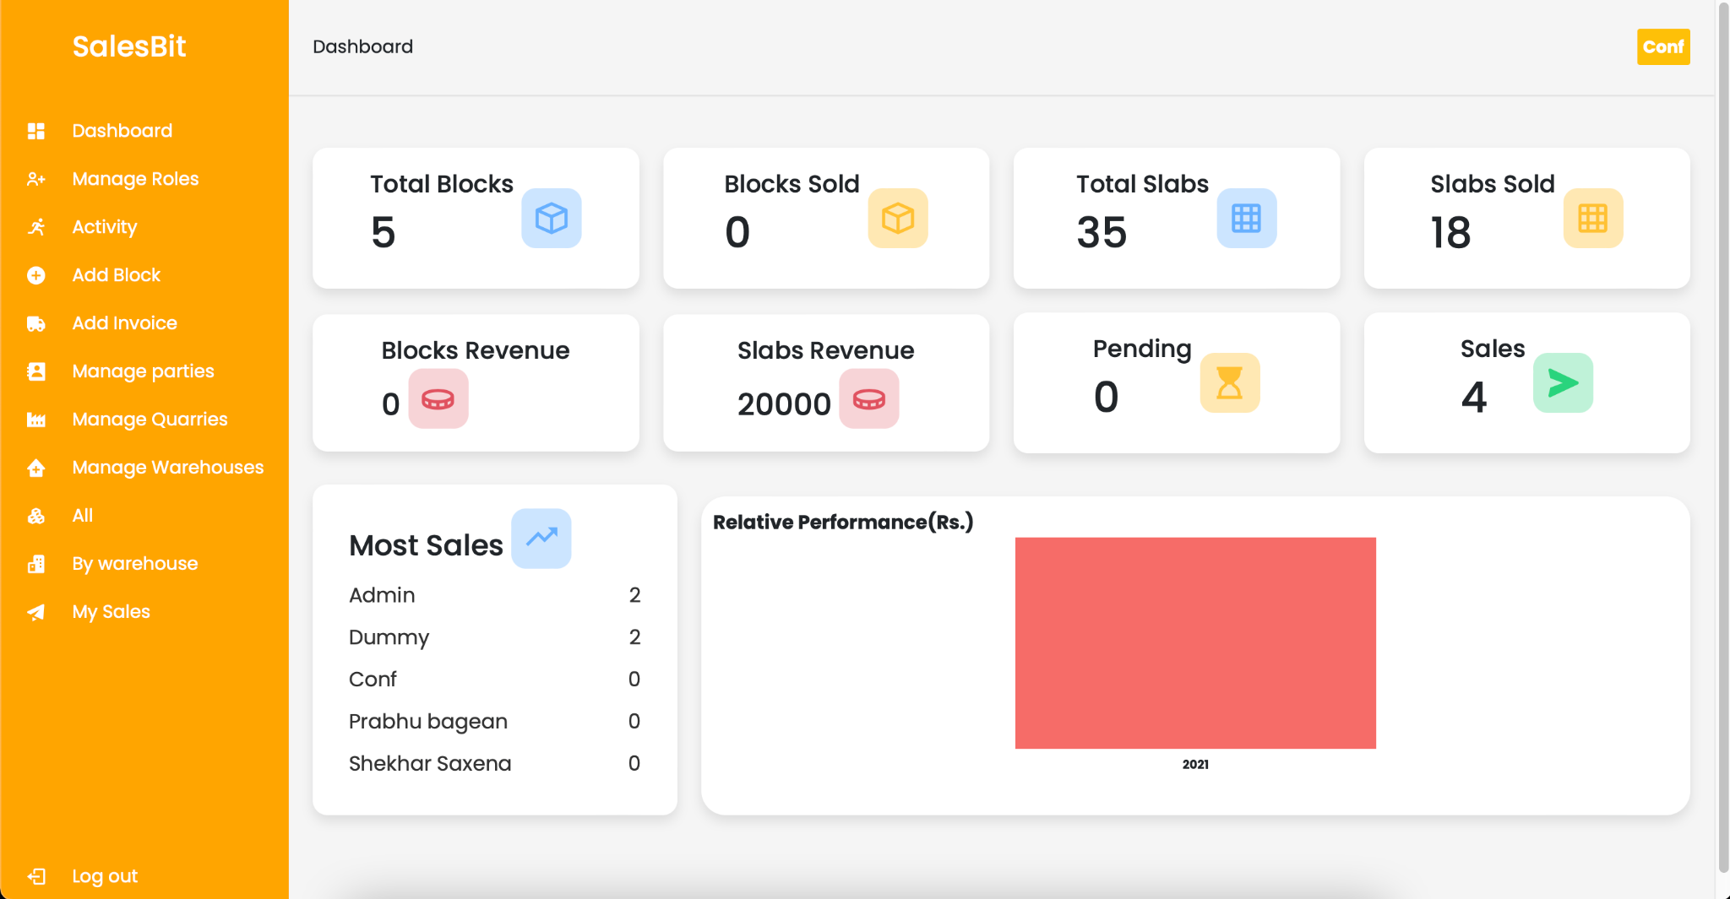

Slide 10
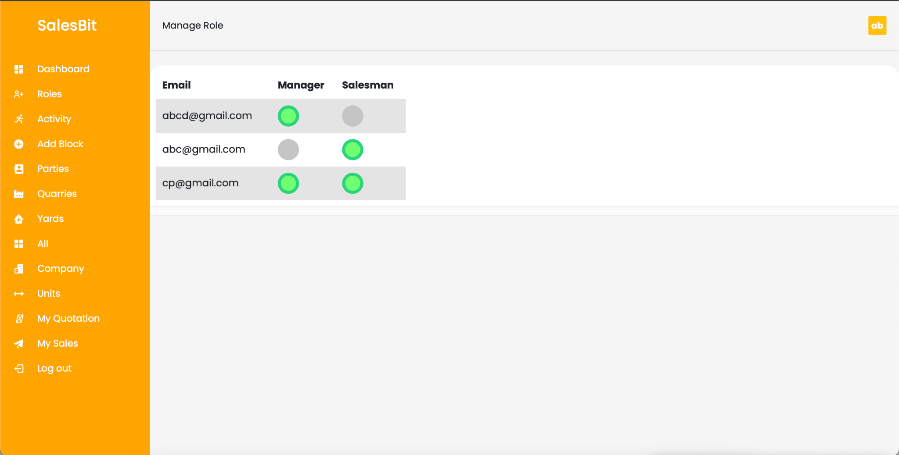

Slide 11
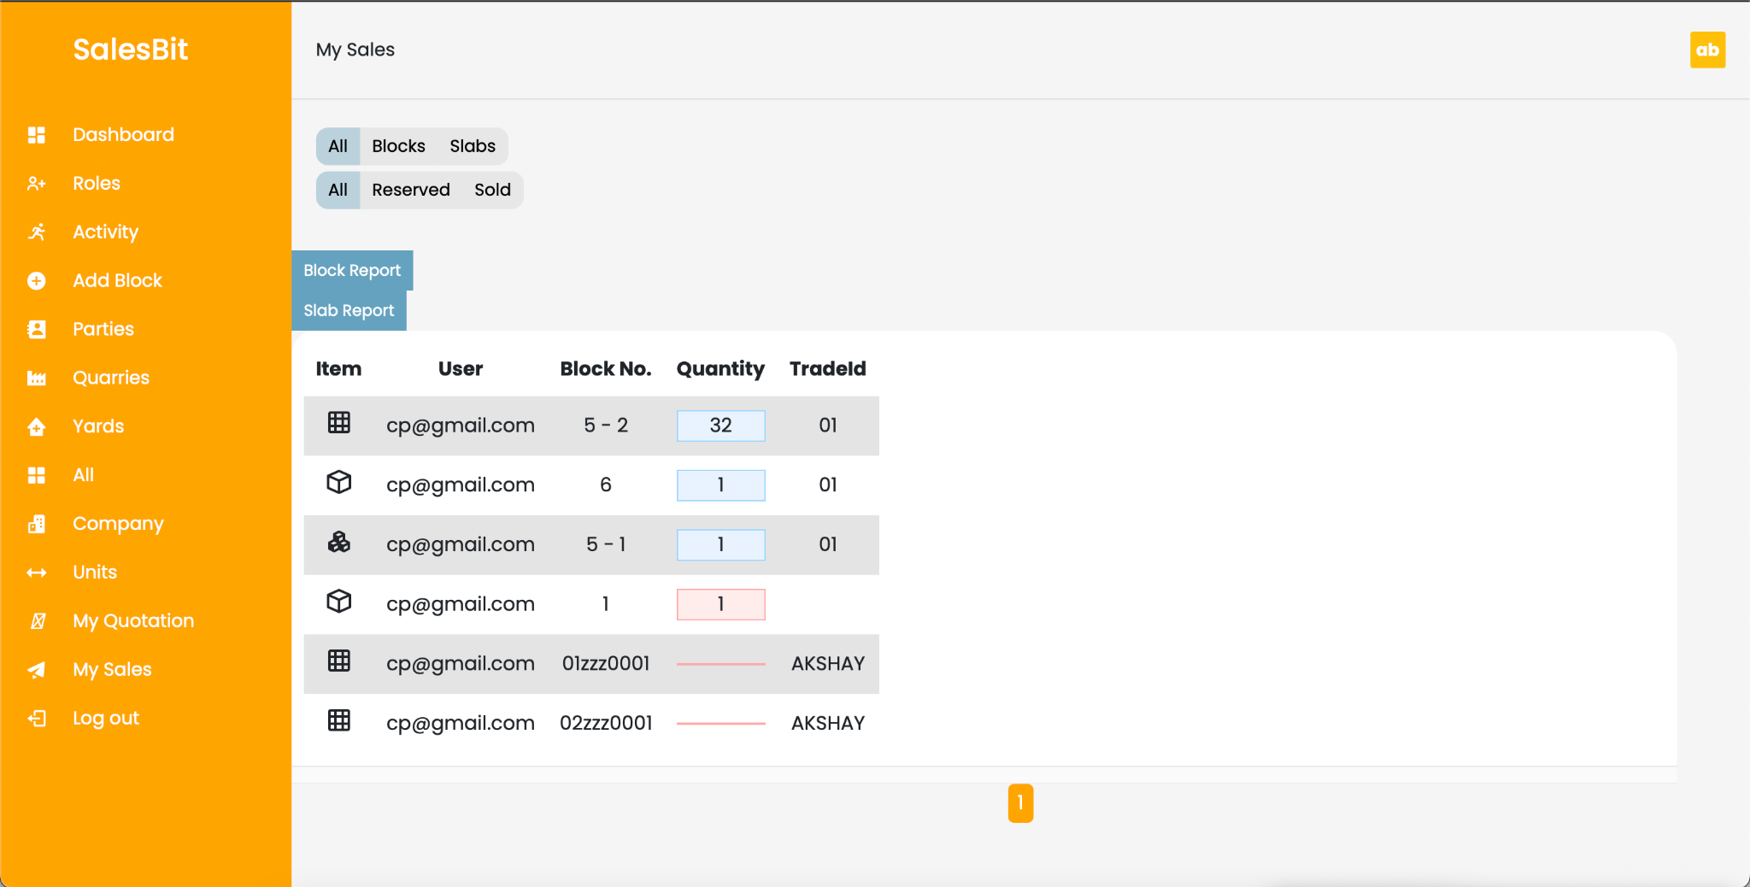

Slide 12
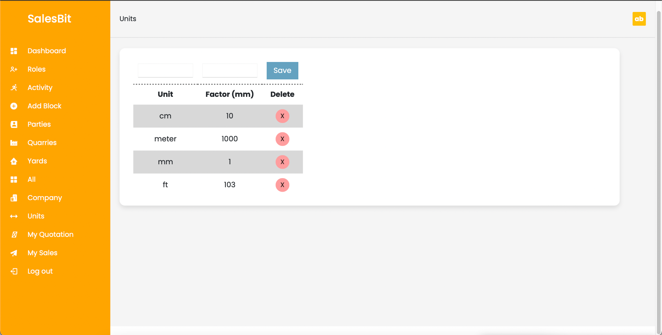

Slide 13
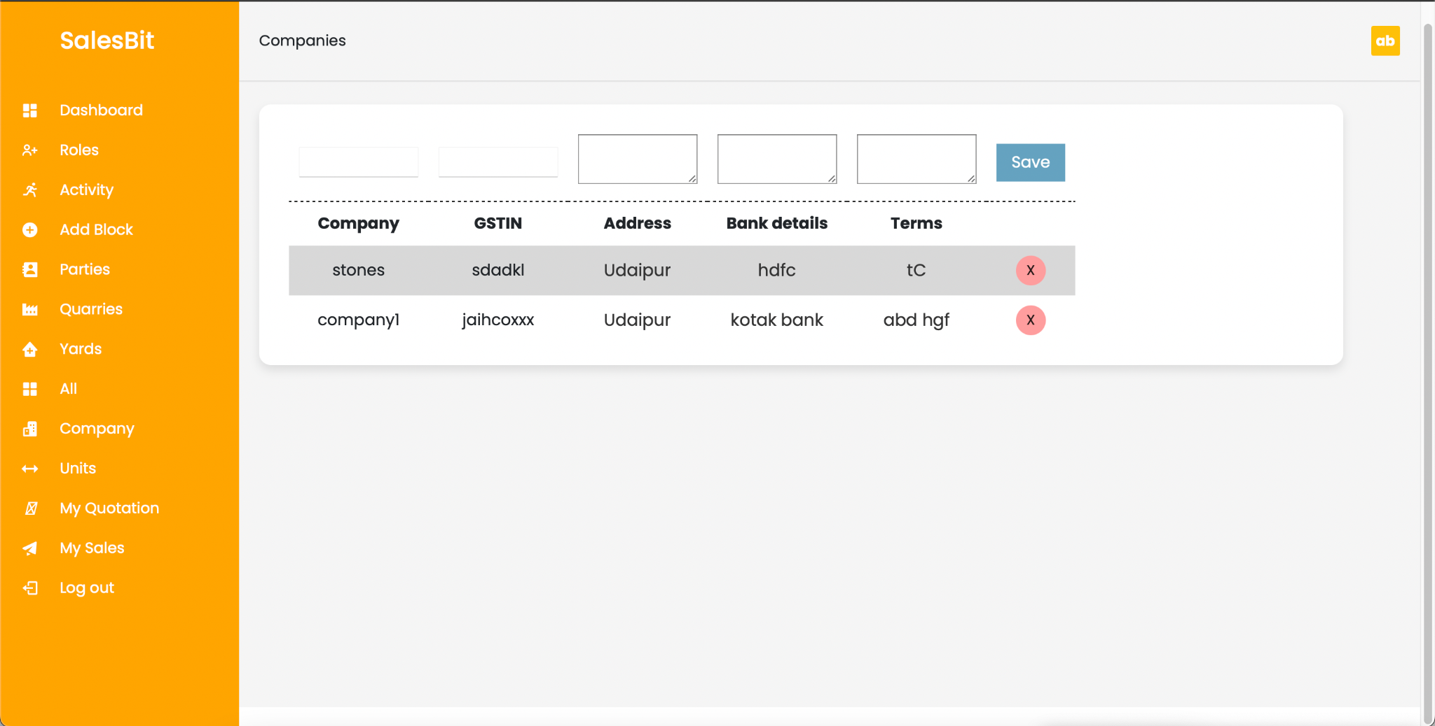

Slide 14
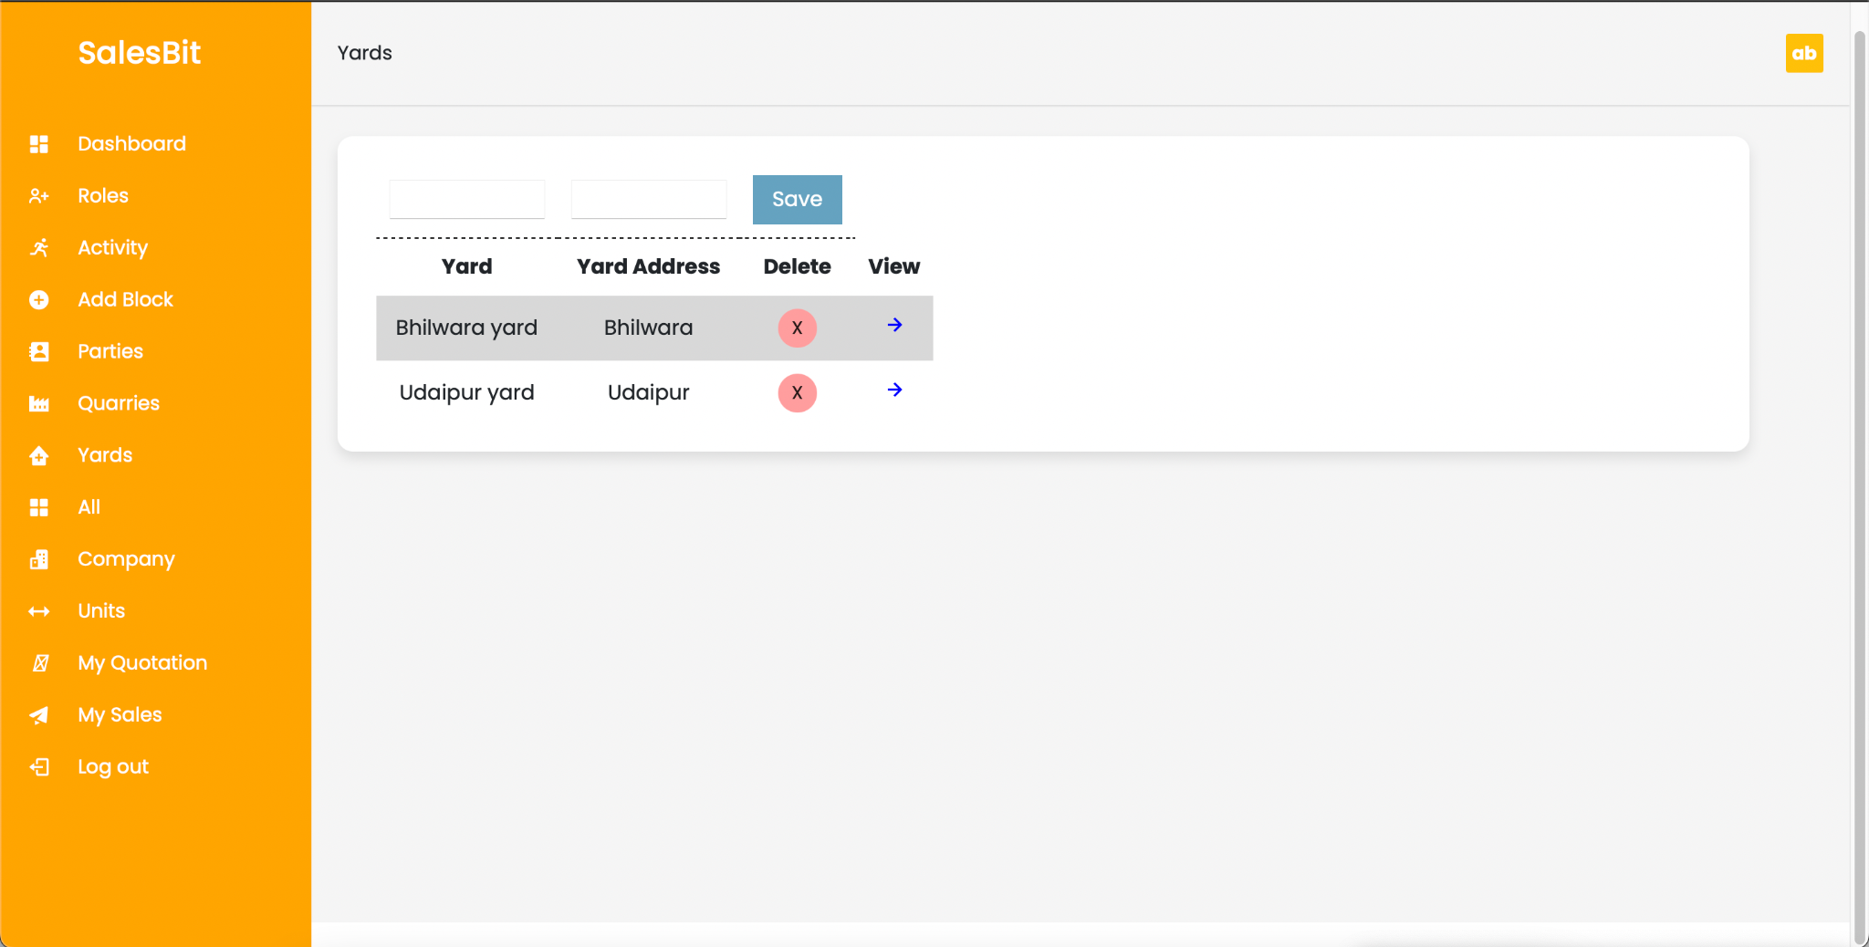

Slide 15
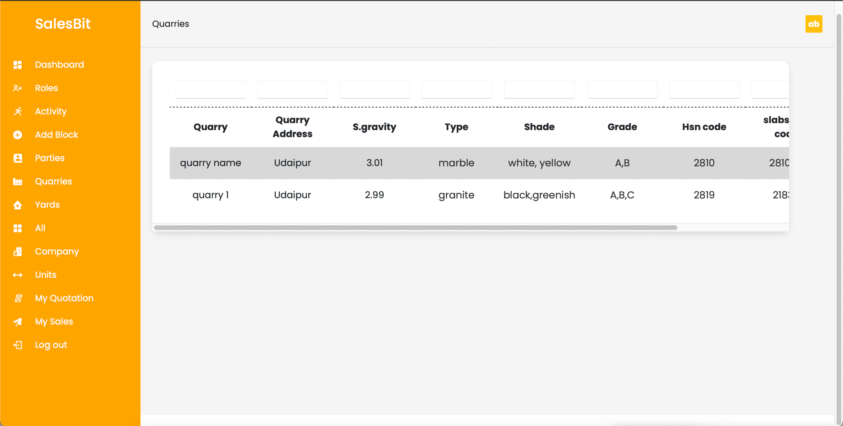

Slide 16
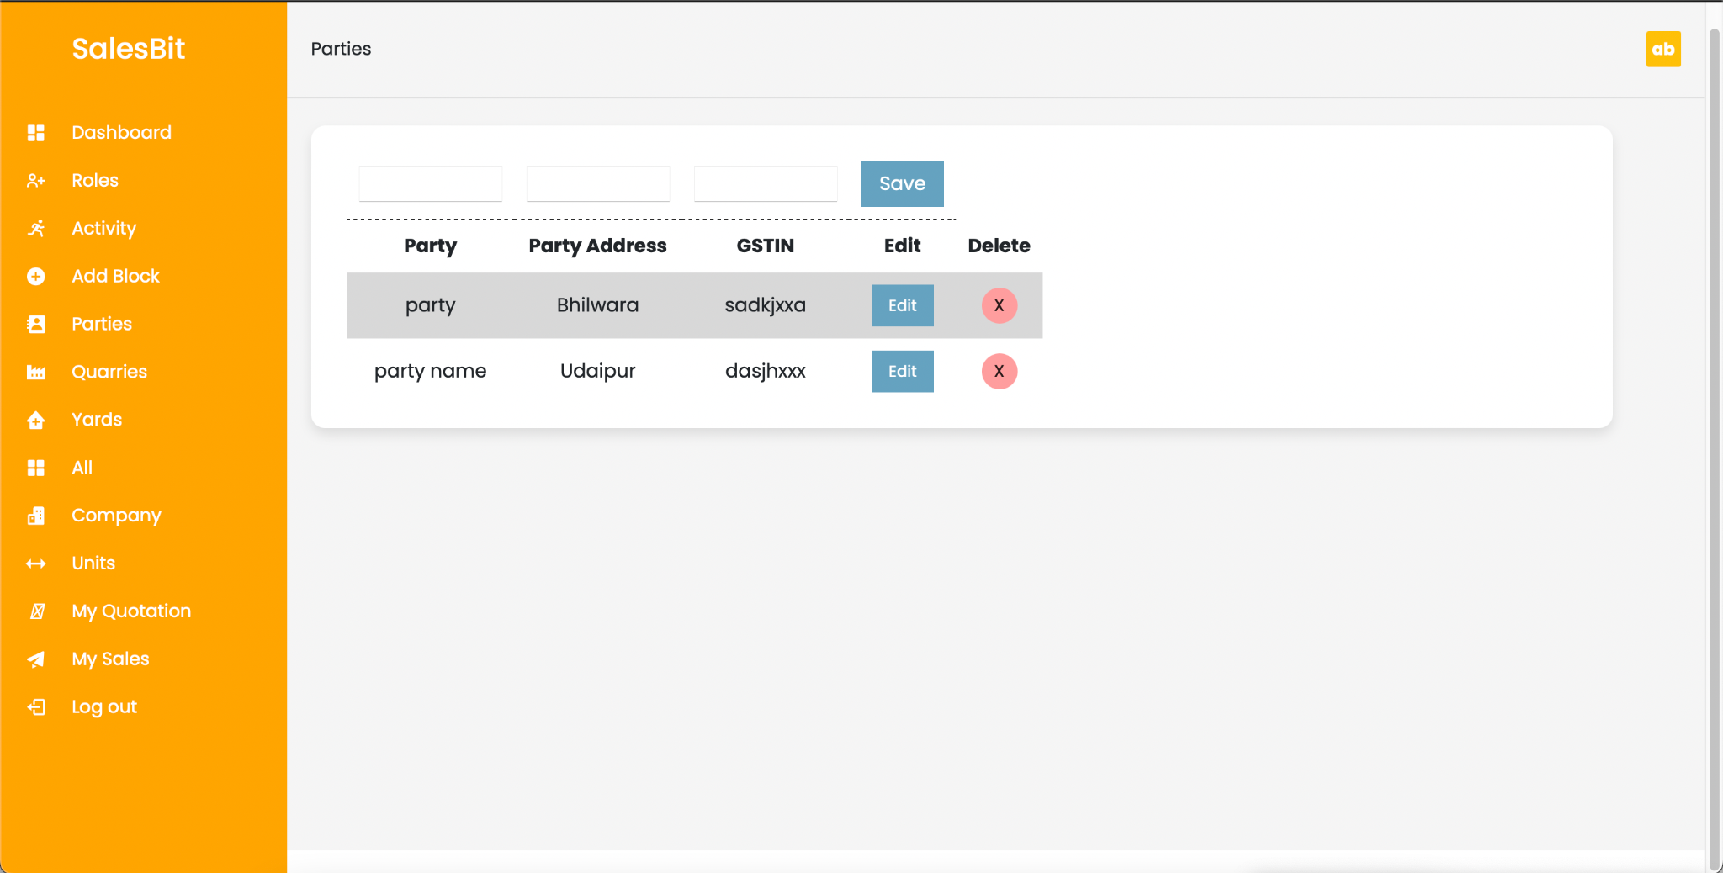

Slide 17
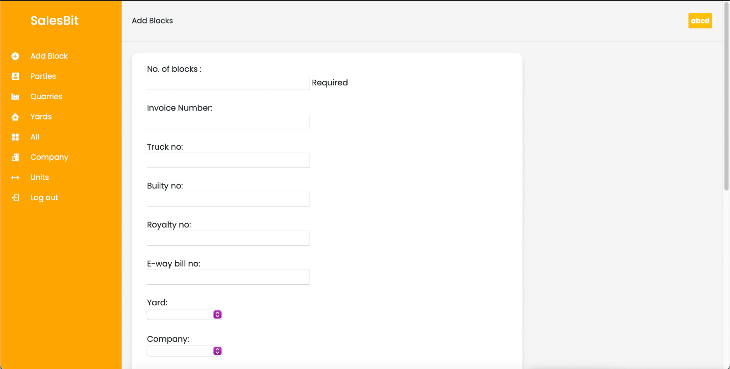

Slide 18
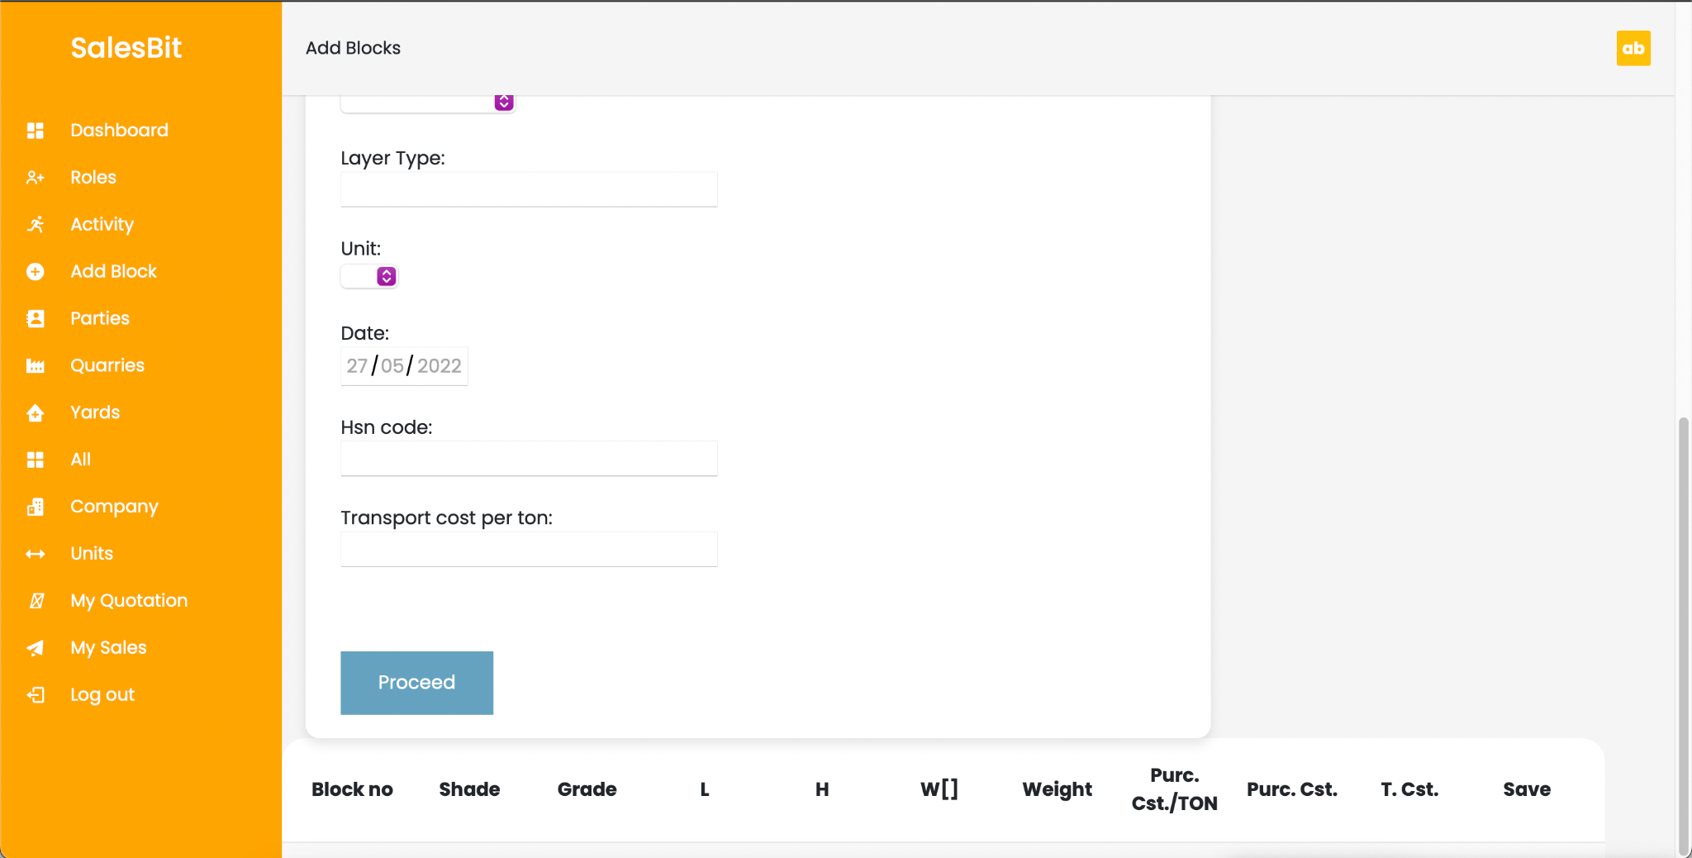

Slide 19
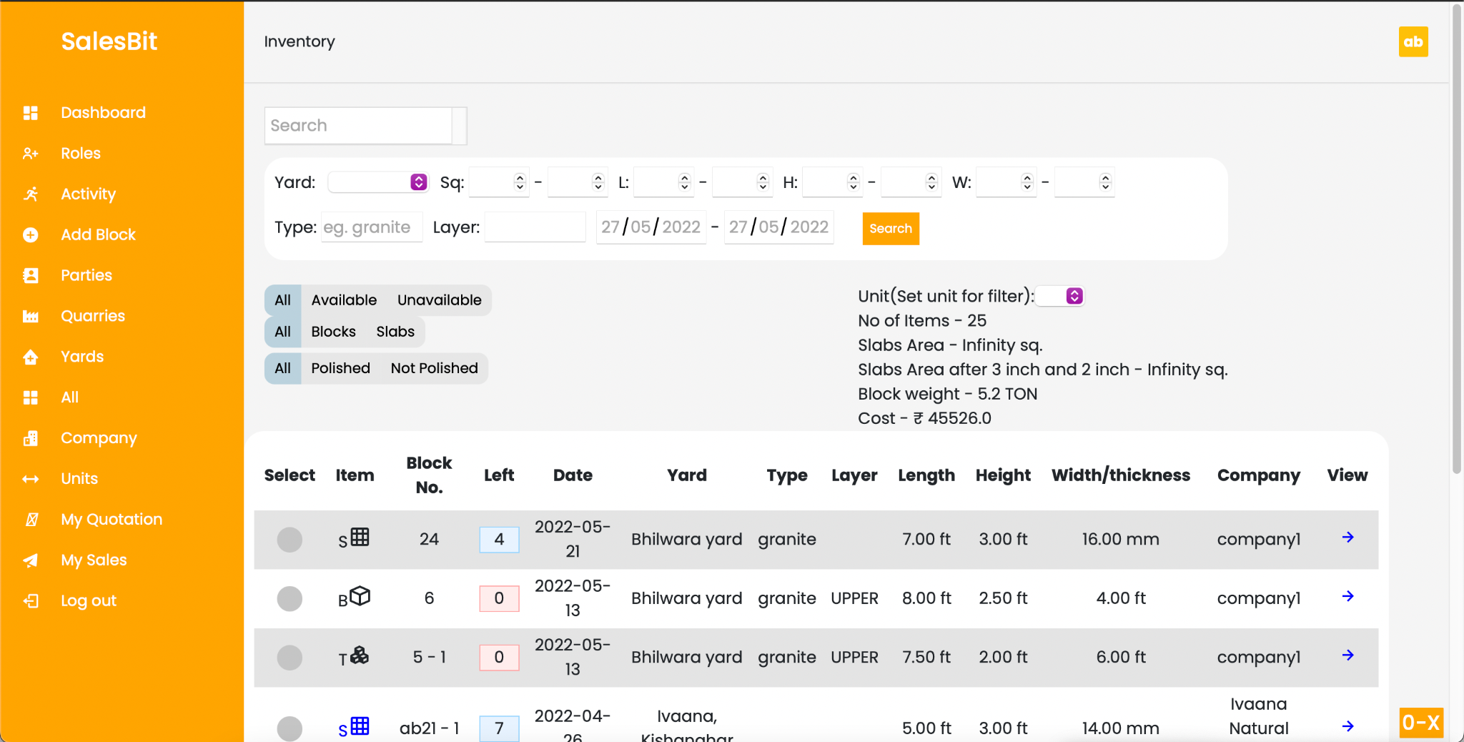

Slide 20
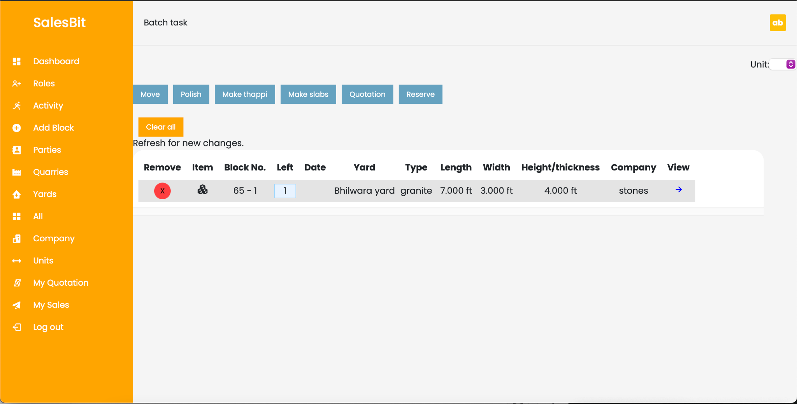

Slide 21
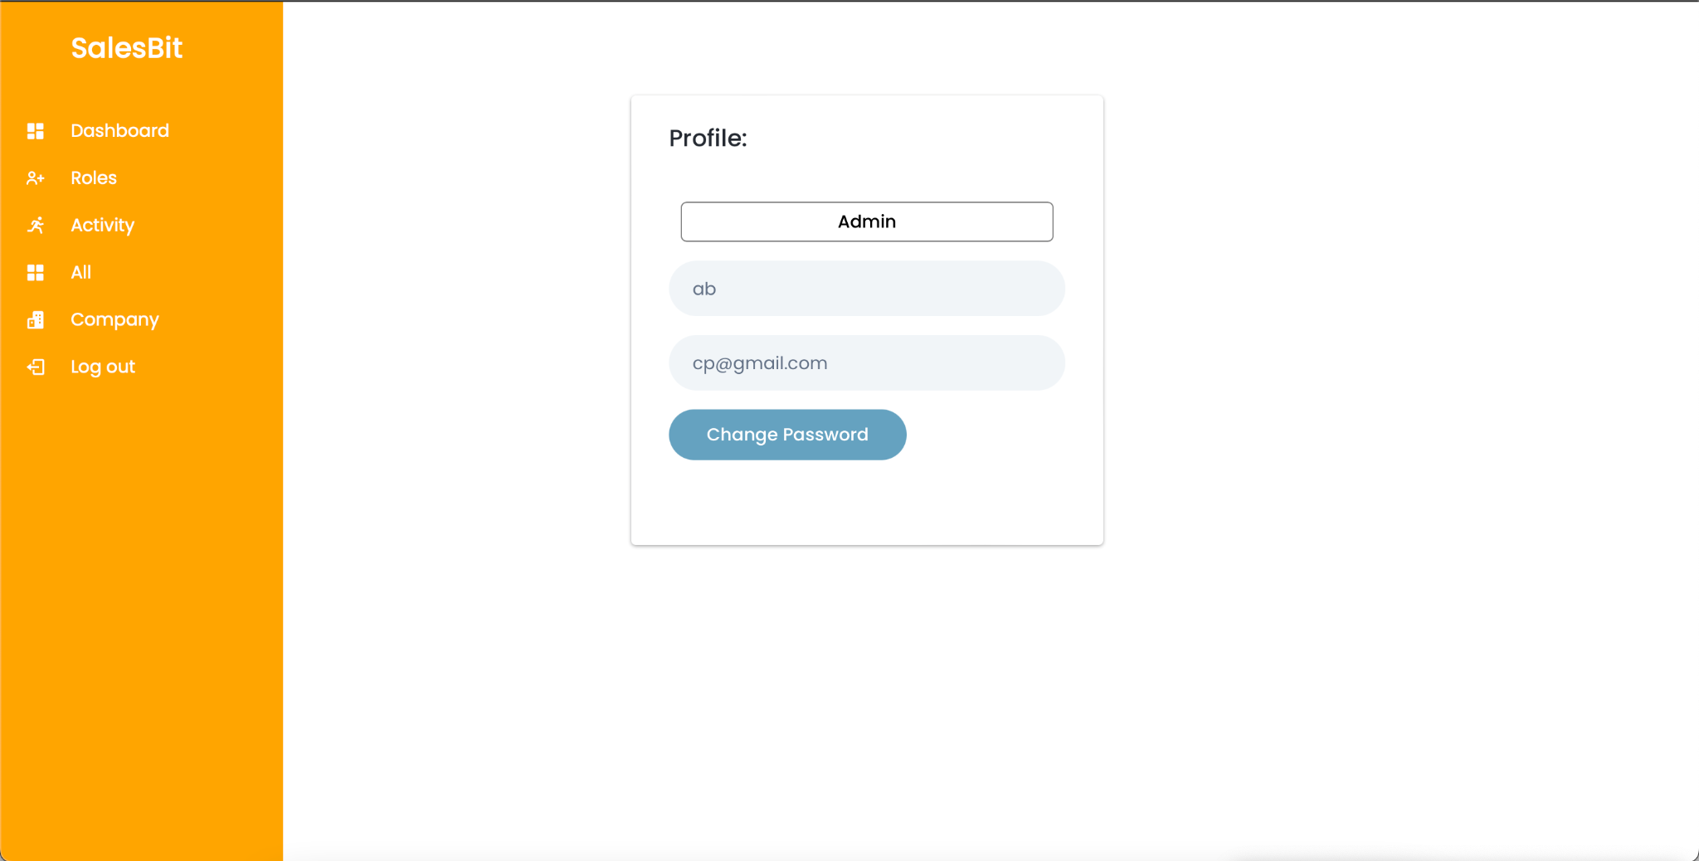

Slide 22
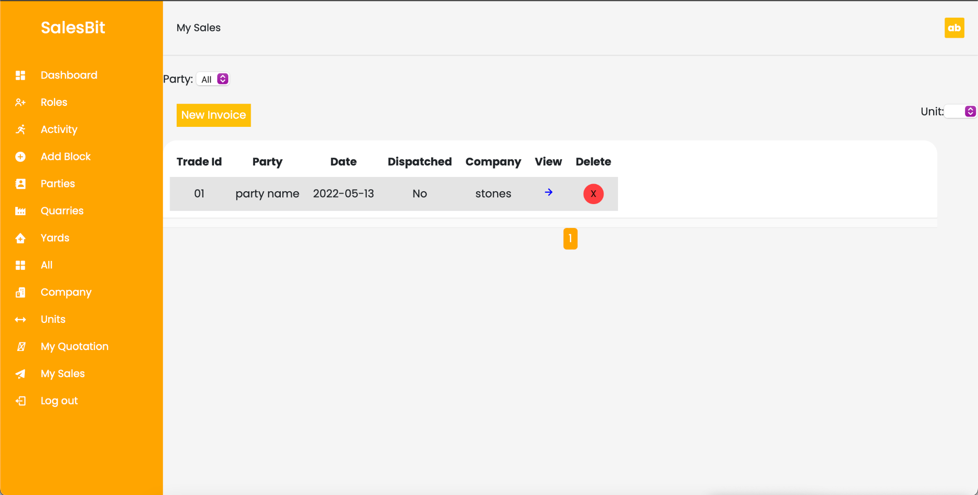

Slide 23
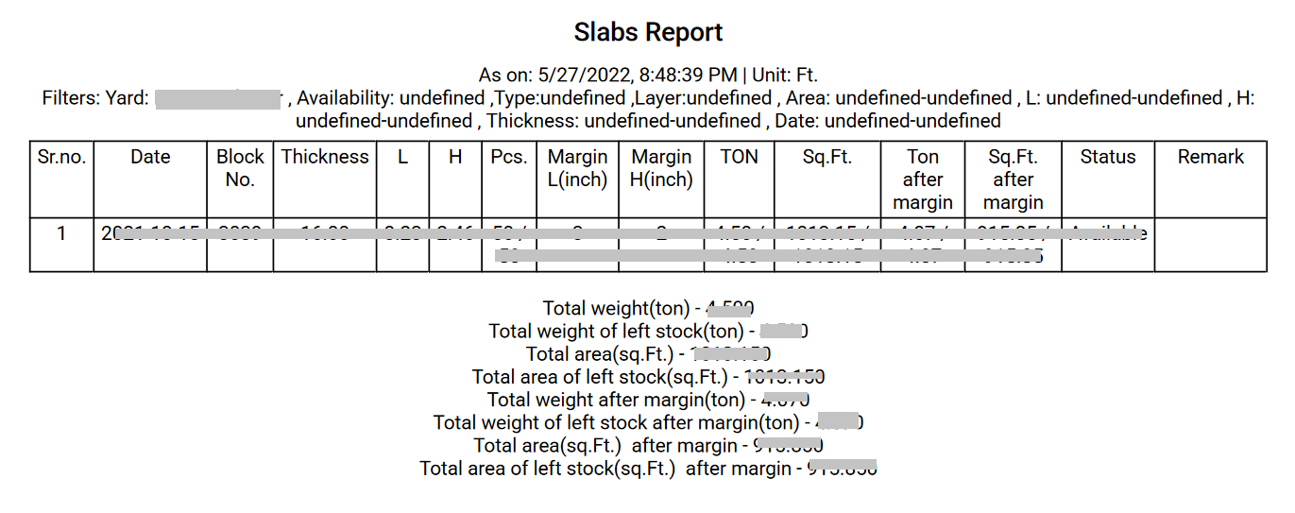

Slide 24
Software ,Dependencies & References
MEAN stack technologies (Mongodb, Express.js, Angular, Node)
Languages - Javascript, Typescript, HTML, CSS
VS code editor
CodingLabWeb.com - for frontend template
Boxicons - for icons
Jsonwebtoken - token based verification
Bcrypt - hashing password before saving
Nodemailer - resetting password
Mongoose - for database layer

Slide 25
Conclusion
Solves the problem of stock and sales management
Reduces the manpower required for managing the data and processes
Improving the business efficiency
Covers all the aspects of stock and sales management
Processing to selling it off

